Slide 1
Python Flight and Ground Software
Learning Objectives of these slides
  To acknowlege and resend packets, a packet serial number is required
  For CS majors, provides in-depth exposure to the program code
  Buffer is storage, Packet is the data being sent
  Queue is a list of buffers
Off-topic objective
  Document implementation for future TA’s and SSI’ers
  Helps prevent bugs
Not an objective
  Your understanding the program code is outside of the AA136 goals.

Slide 2
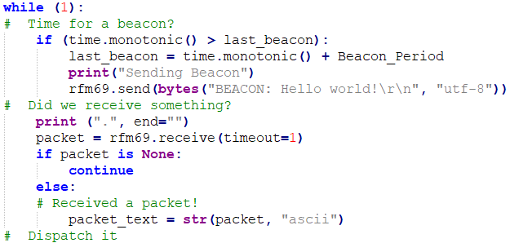
Simplest Satellite Loop
Like when you drive a car, your attention switches regularly from in front, behind, left and right mirrors, speed. And occasionally, gas gauge.
While (1): infinite loop at full speed
Note method for timing beacon
Print . Is a heartbeat
Receive is a blocking wait of 1 second
Receiver is turned off for processing
--> This is fine, but significant computation time can miss
received packets, which overwrite the buffer in the chip and are lost

Slide 3
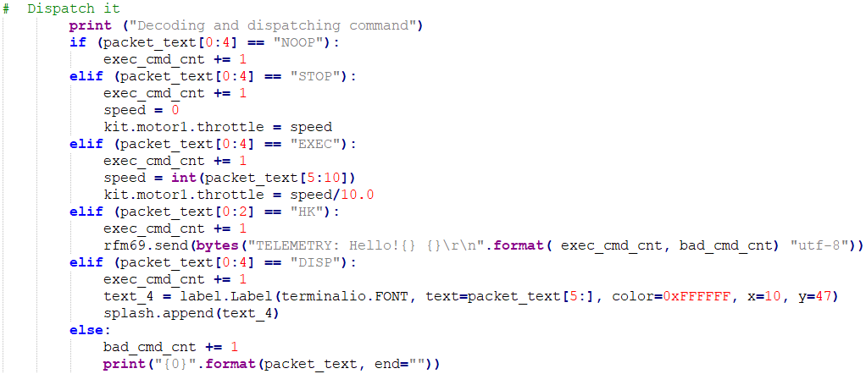
Satellite Dispatch
Figure out the command and perform the right tasks
Series of “if” statements
  Sensitive to case and leading spaces
EXEC gets new motor speed from GS
HK responds with command counts
  Can tell if last command was accepted if HK before and after command is requested

Slide 4
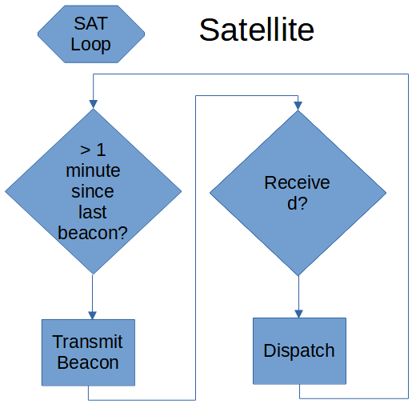
Flowchart for Simple Loop
Sequential
Paced by receive period

Slide 5
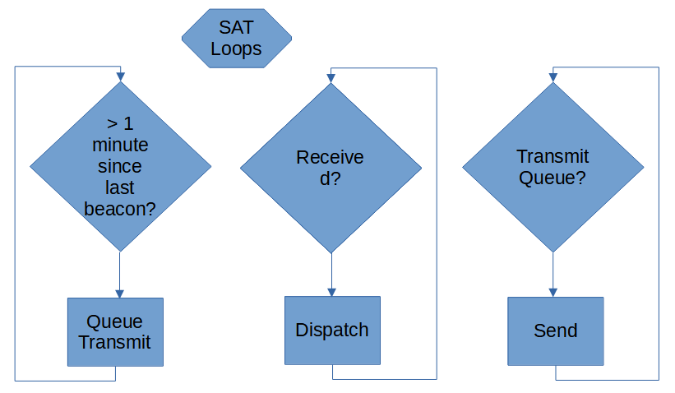
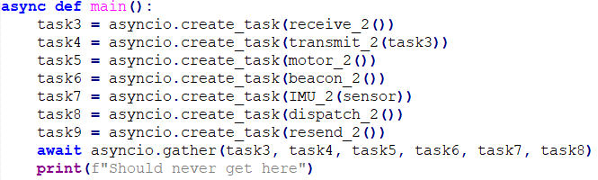
Flowchart for asyncio Loop
Receiver is mostly on
  Only turned off to check if a packet came in and when transmitting
Python manages sharing of execution time

Slide 6
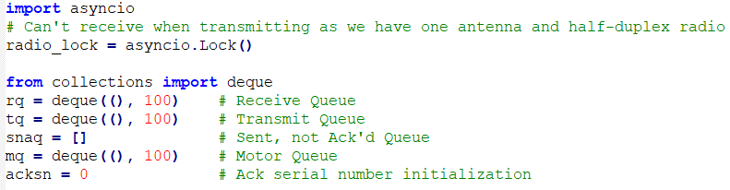
Globals for asyncio
Deque is a fast implementation that can only append to the right and pop from the left in CircuitPython
Snaq is a more versatile but slow queue
CircuitPython can be buggy with globals

Slide 7
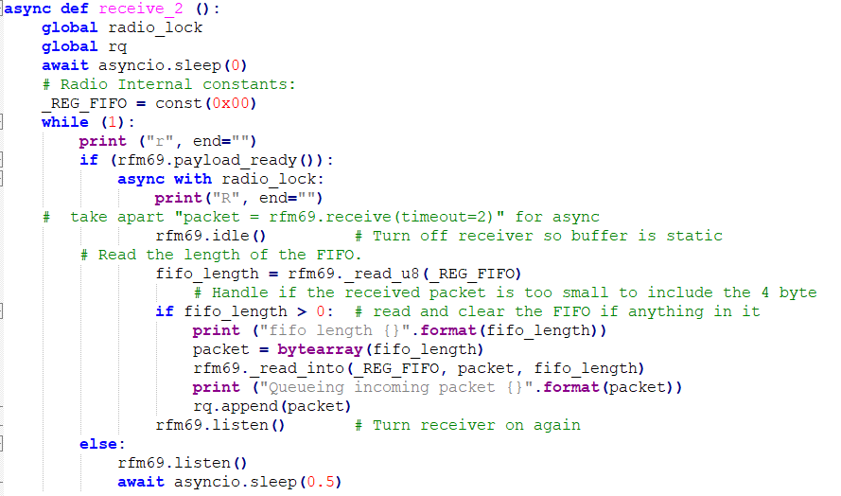
Receiver
Big performance improvement comes from turning receiver on and then giving control to Python to let it do other things
If a burst of packets comes in, receiver doesn’t give control back to Python, it queues up the incoming as fast as possible
  No dispatch in receiver
Required opening up rfm69

Slide 8
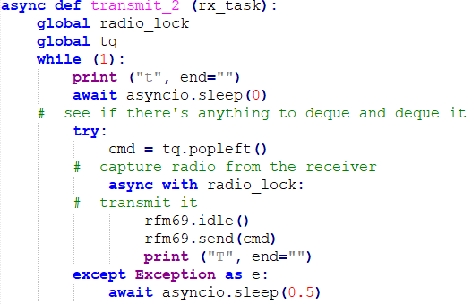
Transmitter
Must wait for receiver lock to be released
Even if we had 2 radios, transmitting while receiving would overload the receiver
If there are a lot of queued buffers, it will send whenever we are not receiving.
When buffer is empty, it not check as often, prioritizing the receiver.

Slide 9
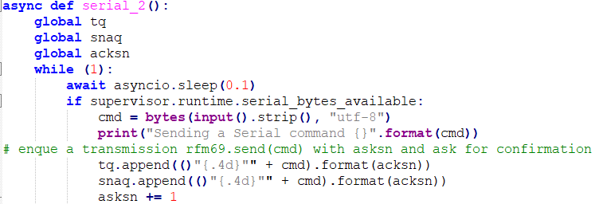
Send a command
Use supervisor to see if bytes are available from Mu-Editor Serial window
Append to the transmit queue
Also append to snaq (sent, not acknowledged) queue
Increment packet serial number
Same as in the IMU command generator

Slide 10

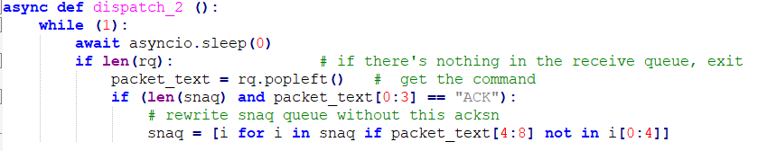
Resend Missed Packets
Notice long sleep wait. This deprioritizes sending missed packets.
Dispatch has a new command, “ACK”, which the recipient sends with the serial number of the packet being acknowledged.

